Slide 1
Introduction to NLP in Tensorflow
Dr Suraiya Zabeen

Slide 2
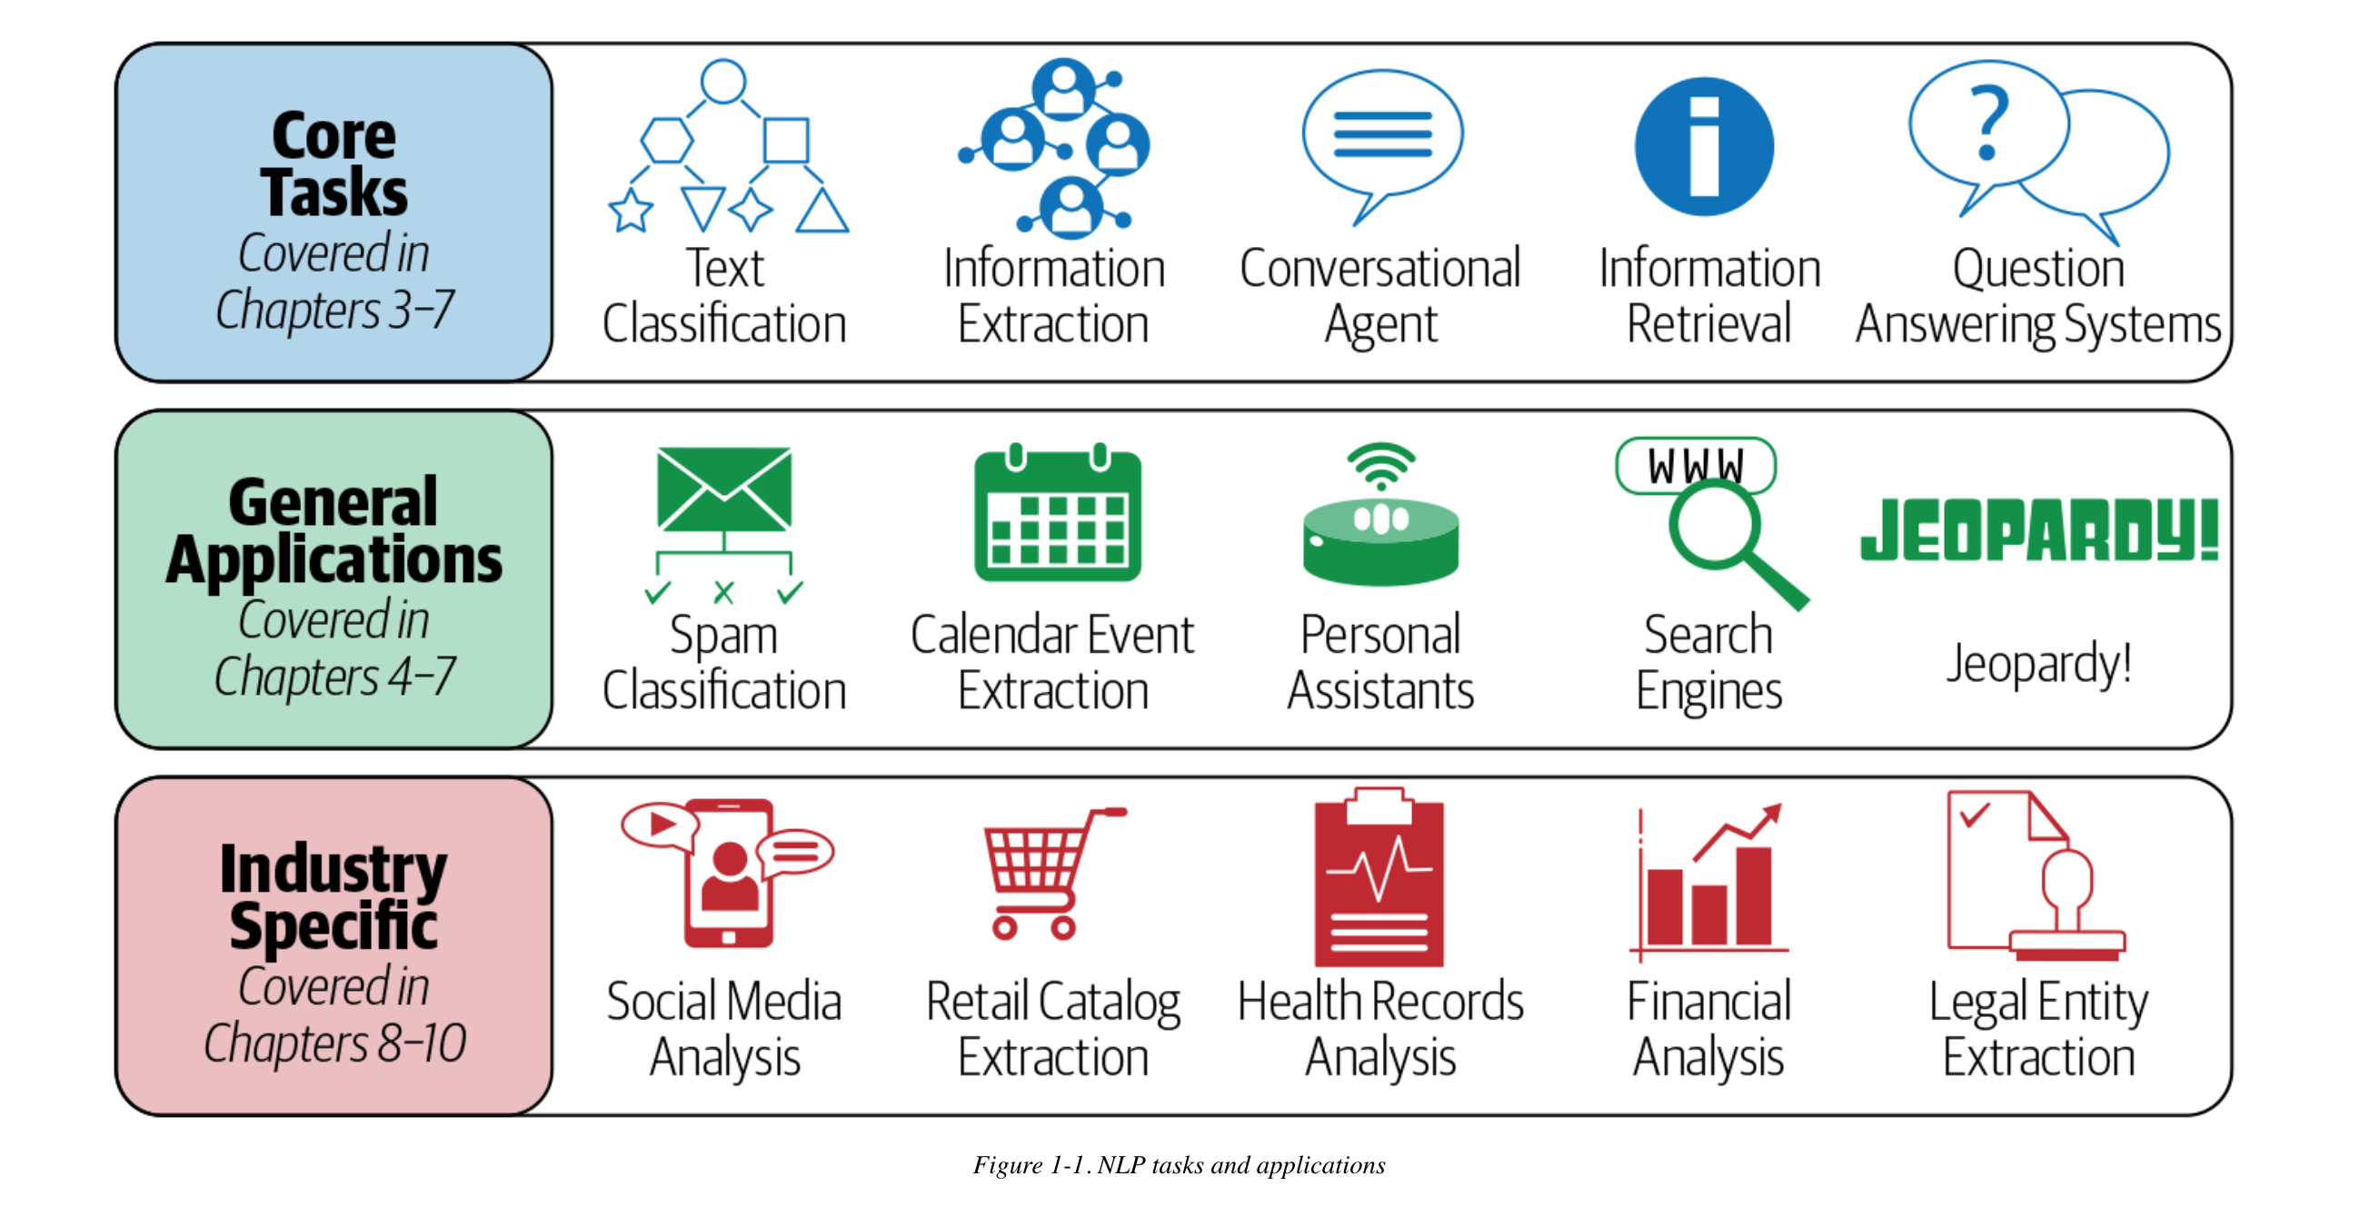
NLP Tasks

